Slide 1
“Planning an eTwinning project”
Contact Seminar:
“ Biodiversity in eTwinning projects”
Irene Pateraki
Hellenic NSS

Slide 2
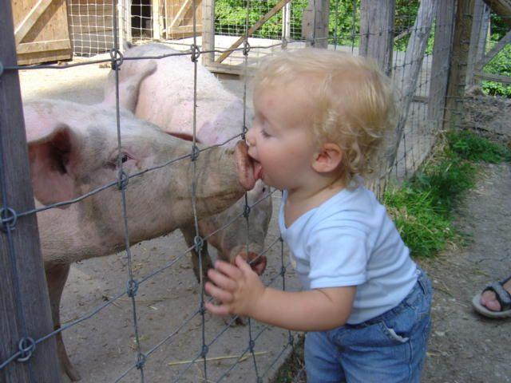
Starting a project sometimes seems difficult…
It’s like when you start a new relationship…
…and you are looking for the right partner
Notes:
A new project looks like a new relationship, as you try to find the right partner to work on a project. Sometimes it can be love at 1st sight and sometimes it may look difficult but you don’t need to feel disappointed…there is always the right person to work with

Slide 3
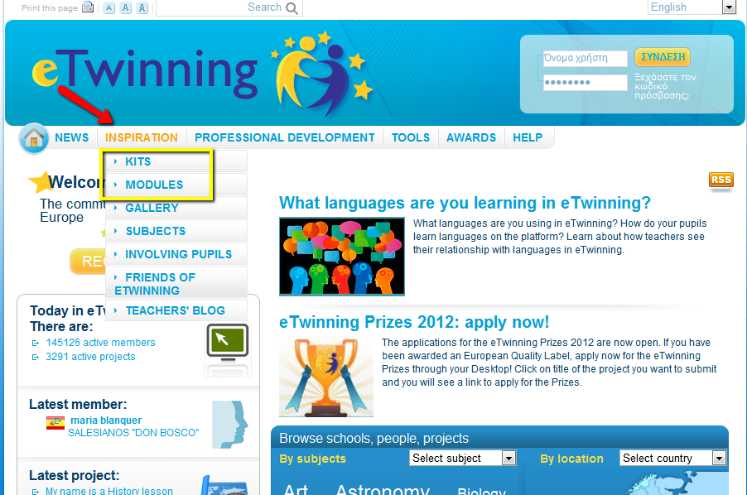
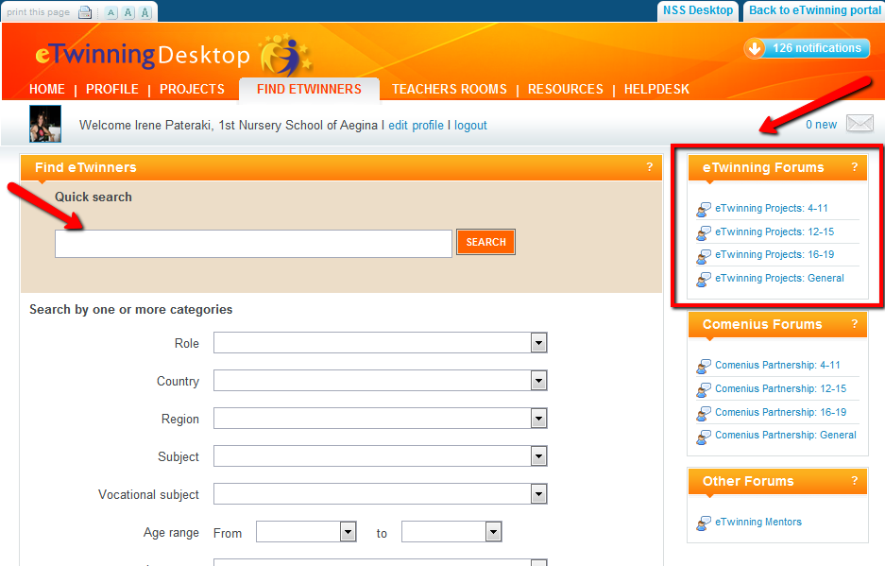
In eTwinning you can try by using:
Partner finding search engine and the Age forums in your Desktop to look for the right partners
Visit inspiration section and take a look in the kits and modules to take ideas
Notes:
In eTwinning you can search for your partner by using….of course you are lucky in that unlike most eTwinners, you may not need to resort to the forums and surf profiles to find new partners, as you have the opportunity to meet in presence!

Slide 4
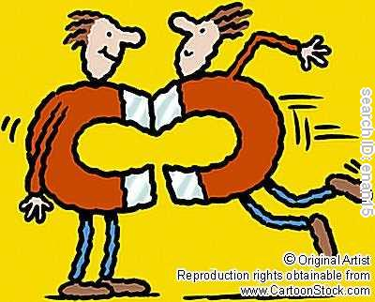
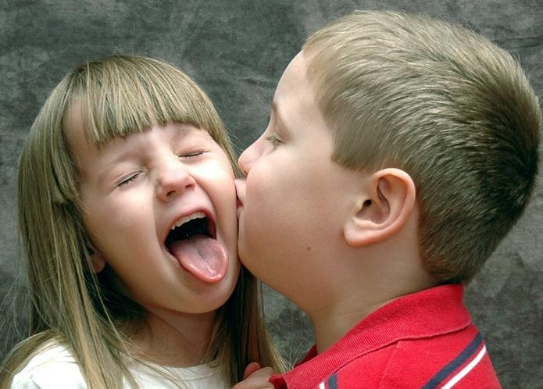
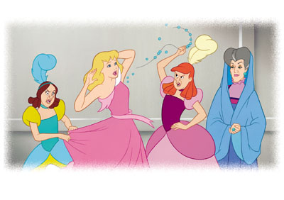
You found your new partner and now?
It’s time to bring together your children(pupils)!
How can you help them find common goals?
Will it be easy for them to collaborate?
Notes:
You have found your partner, have noticed that you share common thoughts and goals. What happens next? Imagine that you are both having your own children, these are your pupils, and you have to encourage them to get along. Is it easy for them to collaborate? What do you have to think about? How can you meet the needs of both sides? How can you help them start collaborating?

Slide 5
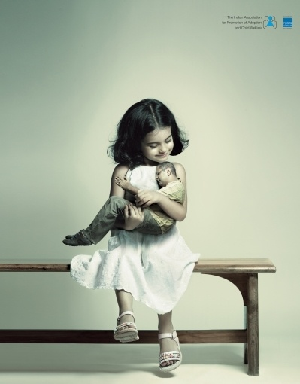
Both partners should bear in mind to meet their children’s needs!
Notes:
Discuss with them and agree on a theme that interests both parties. You should always have in mind their needs and not your own needs (ambitions). After all, you are doing this project for your students so they should have a saying in all steps from planning to evaluation!

Slide 6
Wedding vows= project goals and KISS rule!
Notes:
It is really important to set your goals when you start a project. To know what you want to achieve. Of course during the year new goals can be added according to new conditions. But it’s important to make clear from the beginning what you want from each other!

Slide 7
Problems may arise; be ready to find a solution!
Notes:
It’s difficult to foresee difficulties but you should be flexible in order to face them. Maybe an activity doesn’t work out as you expect; make your evaluation and plan something differently. In case your pupils are not very interested in organizing an activity proposed by their partner, be ready to make changes and adjustments. You can avoid some difficulties if you make a schedule from time to time: for example, know when your partner will be away for vacations.

Slide 8
Ask for friends’ help = School Teams
Notes:
Sometimes it’s good to ask your friend for advice, about your relationship, your work. Friends can always give a helping hand. Especially in eTwinning projects, your colleagues can give more value to your project as you can use their expertise in a domain you are not an expert…and the results can be really great. As you collaborate with your partner you can collaborate with them as well and create your school team. Working in a school team offers you support and more ideas, while activities and work are shared and the results can be great. Teamwork divides the task and doubles the success.

Slide 9
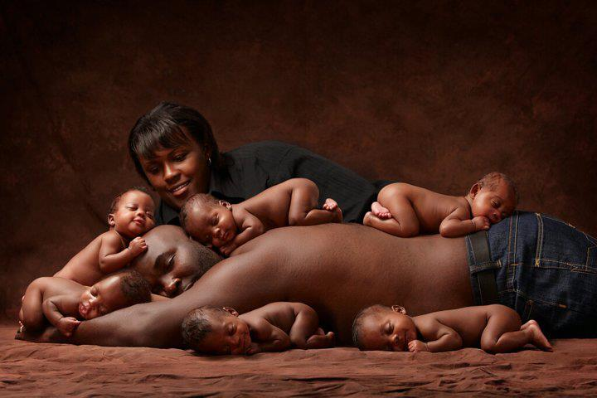
Common dreams that can come true = expected results
Notes:
It’s important to envisage the outcomes of a project briefly. The outcomes can be one or more and while you are working on the project more outcomes may appear. You can organize your work better if you have in mind what you expect and what you want to gain from the activities you organize for your students

Slide 10
And before you start, don’t forget to give a name to this new project!
Notes:
Find a catchy name, something that will describe your work in one line.

Slide 11
Have in mind some golden rules!
Be creative and try to surprise both your pupils and your partner!
Notes:
Try to be creative, maybe if it is your first project you will prefer to do simple tasks, it’s understandable, but as you are gaining experience, try using new ideas and innovative ones.

Slide 12
Don’t forget your methodological and pedagogical friend=NSS
Notes:
Your National Support Service can always help you if you have any difficulty. Use the progress card to ask for advice whenever you need it!

Slide 13
Use tools that will make your life easier
Notes:
…and more interesting . In that way your pupils will surely want to get involved. So machines for your house and ICT tools for your project! Use ICT in a creative way and always according to your goals and activities. Don’t use tools without having in mind your pedagogical goals.

Slide 14
Try to create a good example=transferability
Notes:
An example that can inspire other teachers as well. Your project can be the vehicle for the creation of new projects…

Slide 15
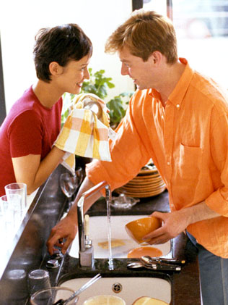
Try to work out together all chores=collaboration
Notes:
Collaboration is the most important factor for a good relationship, for a successful project. Don’t just do activities with your pupils and share them with your partner. Collaborate to create common outcomes, common activities.

Slide 16
And some tips to help pupils collaborate
Compare
Confront
Share
Build together
Interact
Notes:
Compare (ecosystems, species,..)
Confront : the way biodiversity is protected (how, where, why..) => (necessity to expose and debate)
Share (documents, tools, data…)
Build together : PP presentations, movies, mini-encyclopedia, virtual herbarium, ecosystems studies (two groups of pupils from two different countries study the same ecosystem (chestnut or oak forest for example). They share their results, investigations, pictures, sketches,...
Interact : make quizzes for the partners, cross evaluations (same goals, same directions, same criteria to evaluate the work, a national group evaluating the pupils from another country, criteria can be built collaboratively (using forum,..)

Slide 17
“Coming together is a beginning. Keeping together is progress. Working together is success…” Henry Ford

Slide 18
Thank you!

